Slide 1

RUNGTA COLLEGE OF DENTAL SCIENCES & RESEARCH
PLAQUE CONTROL IN CHILDREN
DEPARTMENT OF PEDODONTICS AND PREVENTIVE DENTISTRY

Slide 2
Specific learning Objectives
Core areas | Domain
Introduction Dental plaque | Mechanical plaque control Chemical plaque control

Slide 3
Category
MUST TO KNOW
NEED TO KNOW
Techniques of toothbrush
DESIRE TO KNOW
Chemotherapeutic plaque removal
Disclosing solutions
Dentifrices
Tooth brush
Interdental cleaning aids
Guidelines for home oral hygiene.
W

Slide 4
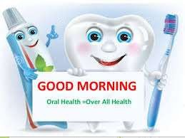
CONTENTS
Introduction
Dental plaque
Mechanical plaque control
Chemical plaque control

Slide 5
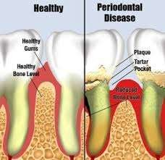
Dental plaque is a complex metabolically interconnected highly organized bacterial ecosystem.
WHO (1978) defined bacterial dental plaque as a specific but highly variable structural entity resulting from colonization and growth of microorganism consisting of various species and strains embedded on an extracellular matrix.

Slide 6
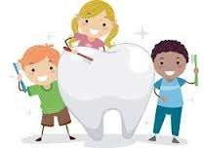
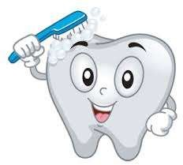
Plaque control
Removal of plaque and prevention of its accumulation on teeth and adjacent gingival surface.
Key to prevention and successful treatment of periodontal disease
leads to resolution of gingival inflammation in early stages and prevent reccurence
can be professional and patient performed

Slide 7
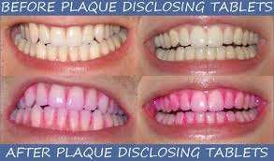
DISCLOSING AGENT
A preparation in liquid tablet or lozenge, which contains a dye or coloring agent which is used for identification bacterial plaque , which is invisible to naked eyes.
INDICATIONS
Patient education,instructions for plaque control,self assessment,evaluation effiectiveness ,assessment of clinician,plaque indices.

Slide 8
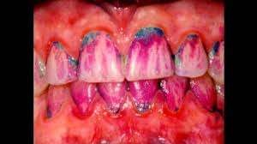
Properties
Intensity of color: distinct staining of deposits
Duration of intensity: color should not rinse of fast
Taste : comforatable, pleasant and flavored
Irritation :should not cause irritation to oral mucosa
Diffusibility :solution should be thin,can be applied readily to teeth,thick to impart color to plaque
Astrigent and antiseptic properties

Slide 9
Agents used for disclosing plaque
Iodine preparations
skinners iodine solution
diluted tincture of iodine
Mercurochrome preparation
Bismark brown

Slide 10
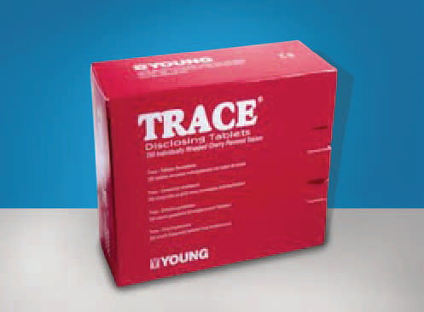
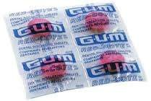
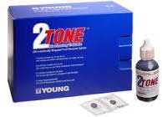
Erythrosine
Two tone solution
Basic fuchsin
Plak light system

Slide 11
Application
Directly applied on tooth surface using cotton pellet or rinsed after proper dilution
Tablet or wafers may be chewed or swished for 30 or 60 sec and rinsed

Slide 12
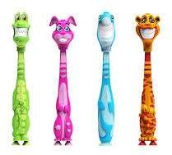
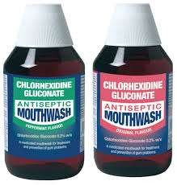
Methods of plaque control
mechanical
chemical

Slide 13

Mechanical plaque control aids | Chemical plaque control agents
Dentifrices | Bis-biguanides and related compounds Chlorhexidine Alhexidine
Tooth brush | Quaternary ammonium compound ce tylpyridinium
Dental floss | Antibiotics Pencillin,tetracycline,vancomycin,metronidazole
Oral irrigation | Fluoride and inorganic ions Stannous fluoride,chlorine dioxide ,hydrogen peroxide,sodium bicarbonate,sodium chloride
Interproximal brushes | Enzymes Dextranase, glucose amyloglucosidase
Wooden tips | Organic compound Saguinarine,menthol/thymol,soluble pyrophosphates
Gauze piece for infants
Gingival massage
Tongue scrapers

Slide 14
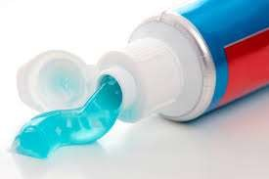
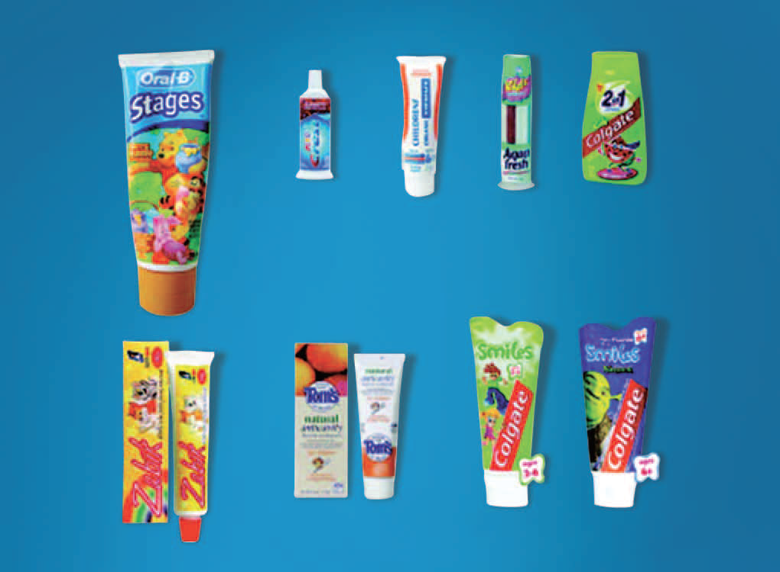
DENTIFRICES
A substance used with tooth brush to remove bacterial plaque, material alba , debris from gingiva and teeth for cosmetic , sanitary ,prevention and therapeutic purpose.
Function
Minimize plaque build up
Anticarious action
Removal of stains
Mouth freshner

Slide 15

COMPOSITION
AGENTS | MATERIALS USED | FUNCTION
Polishing/Abrasive | Calcium carbonate, dicalicum phosphate dehydrate, alumina, silica | mild abrasive action
Binding /thickening | Water soluble agents Alginates ,sodium carboxymethyl cellulose Water insoluble Magnesium aluminum silicate,colloidal silica,sodium magnesium silicate | Stability and consistency
Detergents/surfactants | Sodium lauryl sulfate | Produces foam which aids in removal of debris
Humectants | Sorbitol, glycerin,polyethylene glycol | Reducing loss moisture
Flavoring | Peppermint oil,spearmint oil,oil of wintergreen | Render product pleasant to use and fresh taste
water | Distilled water | Vehicle

Slide 16
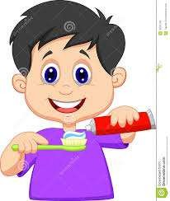
Therapeutic | Tetrasodium,zncl,pyrophosphate | Therapeutic action
Sweeting | Saccharin | Sweetener
Antibacterial | Triclosan,delmopinol,metallic ions,zinc citrate trihydrate
Anticaries | Sodium monoflurophosphate Sodium fluoride,stannous fluoride
Anticalculus | Pyrophosphates,zinc citrate,zinc chloride ,gantrez acid | Inhibits mineralization of plaque
Desensitizing | Sodium fluoride,potassium nitrate,strontium chloride

Slide 17
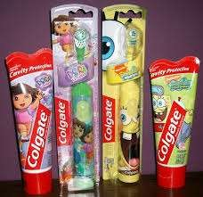
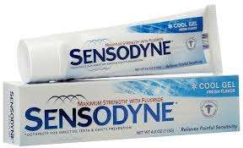
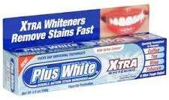
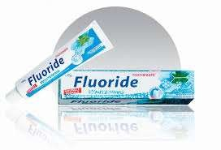
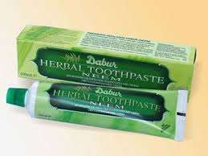
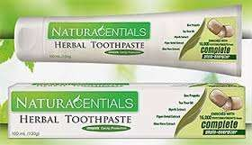
Recent development in dentrifices
Tooth paste for children
Herbal tooth paste
Whitening tooth paste(highly abrasive)
Fluoride tooth paste
Sensitivity tooth paste

Slide 18
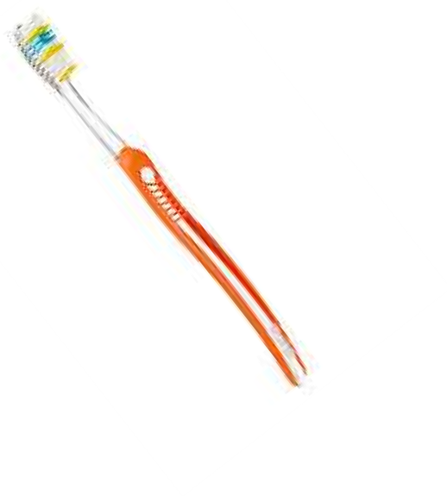
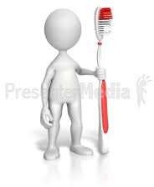
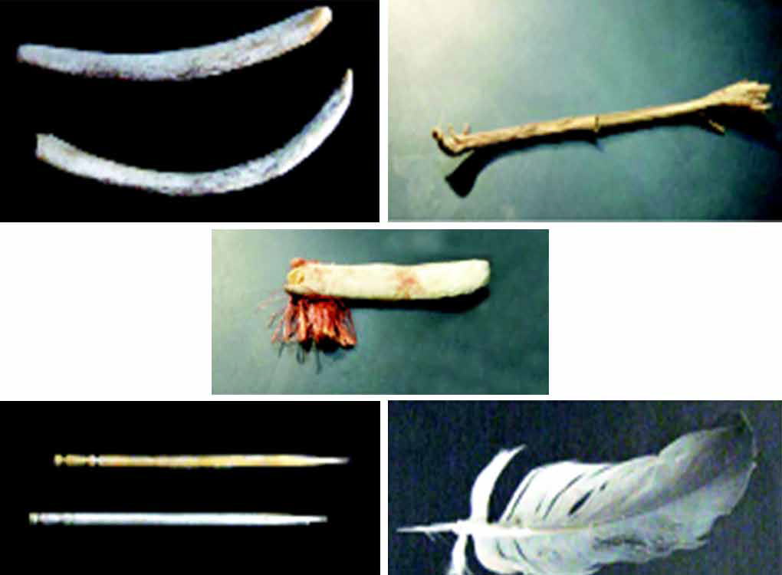
TOOTH BRUSH
The mechanical cleaning of teeth can be traced back to ancient times.
Oral hygiene was practiced by egypitans 5000 years ago.
Romans used tooth picks made of bones and metals.
first bristle toothbrush - China during the Tang dynasty
first patent for a toothbrush - HN Wadsworth
in 1857 (US Patent No. 18,653)
first electric toothbrush – Switzerland in 1954 by Dr Philippe-Guy Woog

Slide 19

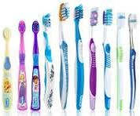
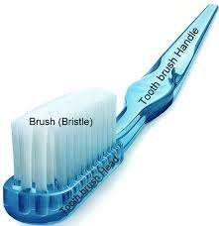
ADA Specification
Length : 1 to 1.25 inches
Width :5/16 to 3/8 inches
Surface area :2.54 to 3.2cm
No rows : 2 to 4 rows
No of tufts :5 to 12 per row
No of bristles :80 to 85 per tuft
Diameter for Soft brush:0.007inch
Medium brush:0.012inch
Hard brush :0.014inch

Slide 20
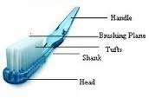
Parts of tooth brush
Handle : grasped in the hand during toothbrushing.
Head : consist of tufts of bristles or filaments.
Shank: connects the head and the handle.

Slide 21
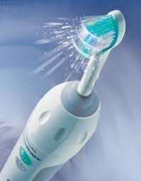
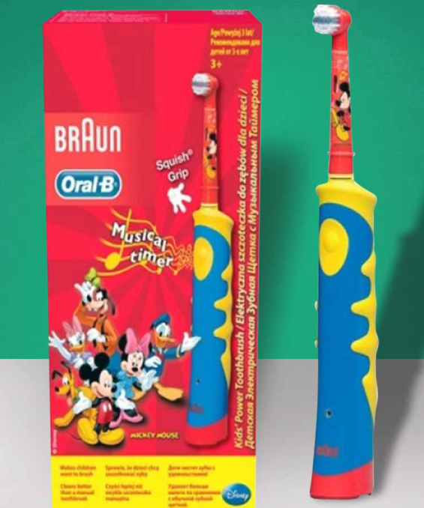
Powered tooth brush
TOOTHBRUSH MODIFICATIONS AND CURRENT CONCEPTS
First electric toothbrush - Switzerland in 1954 by Dr Philippe-Guy Woog
In 1987, Interplak - first rotary action electrical toothbrush
Braun-Oral B kids power toothbrush D10 - most effective in removing plaque in children

Slide 22
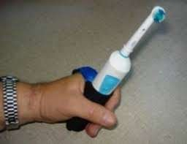
They have three motion back and forth,circular,elliplical.
Recommended for
Individuals lacking motor skills
Handicapped patients
Patients under fixed orthodontic treatment.

Slide 23
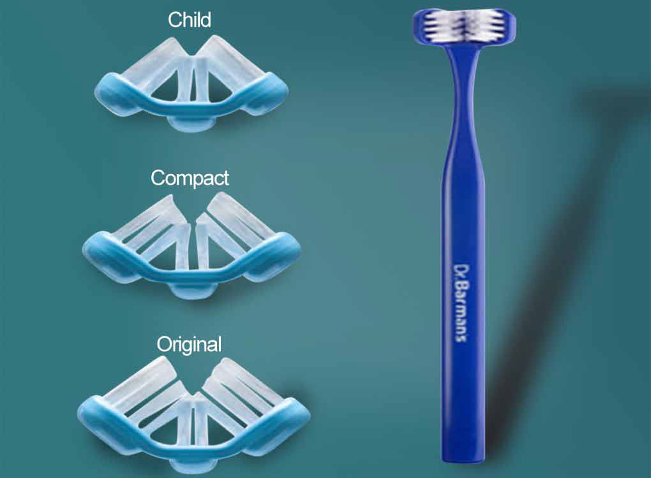
SUPERBRUSH
Simultaneously clean the outer, inner and chewing surfaces of teeth
All the three surfaces of the tooth are cleaned simultaneously

Slide 24
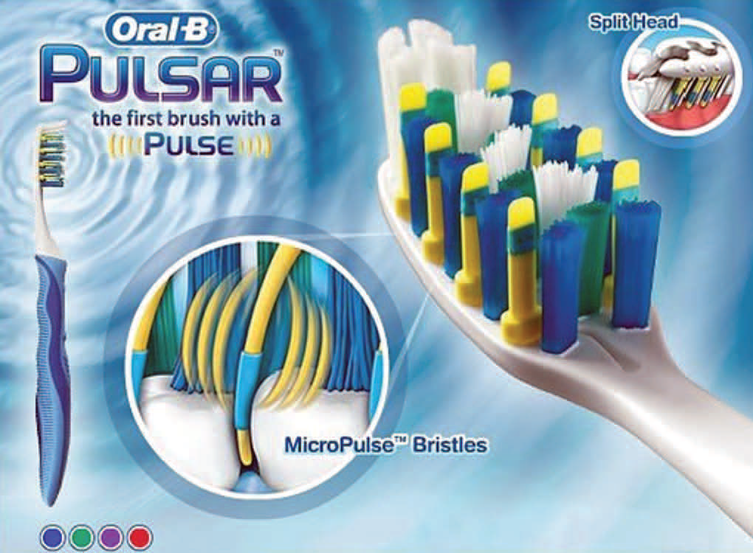
Pulsar Toothbrush
New concept - pulsating chip is embedded on the base of bristles.
• soft vibrating bristles
• Oral-B Pulsar - first to incorporate this technology.

